Slide 1
Learning by doing
Digitization of cold war and
human rights AV collections at OSA using ffmpeg-based solutions_a case study
Zsuzsanna Zadori
Head of AV Unit OSA zadori@ceu.edu
Notes:
Thank you for including us into the program. Together with 3 of my colleagues at OSA, Darius, János and Josh we’re happy to present our collaborative AV digital preservation project to you at nttw4.

Slide 2
OSA is part of CEU
1995
facilitate research + education
Founding fonds: RFE/RL Research Institute’s material
#coldwar #humanrights
Notes:
The Open Society Archives was established in 1995, and is part of the Central European University, CEU. This was the year when Radio Free Europe/Radio Liberty, closed down in Munich, Germany and moved to Prague. RFE’s research Institute’s massive archive and library was deposited at OSA, and it is our first fonds. It is a special cold war and human rights archive in itself.

Slide 3
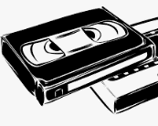
AV holdings 2019
15’000 hours of time based media
80% analogue
film video audio
500’000 photo prints + negatives
95% analogue
in over 70 archival series
Notes:
As of 2019 OSA has over 150 fonds. The AV holdings comprise over 15 thousand hours of time based media. Approx. 80% of them are analogue: film on celluloid, video and audio cassettes. OSA also has about half a million photo prints and negatives in over 70 archival series.

Slide 4
Video formats
VHS PAL + NTSC
S-VHS PAL
BETA SP PAL + NTSC
Hi8
MiniDV
U-MATIC
+ DIGITAL, various codecs, unconsolidated
Notes:
OSA’s video is on vhs, svhs, betacam sp, hi8, mini dv and some u-matic. The digital video is growing getting bigger and bigger, and it is yet unconsolidated. It is scheduled as our next project, for 2020.

Slide 5
Audio + Photo formats
Open reel tapes ¼ inch
MC
born digital. various codecs
b&w prints
color prints
35mm b&w + color negatives
born digital. various compressions
Notes:
The audio and photo formats are less diverse. We have ¼ inch open reel tapes and audio cassettes, bw and color prints and 35mm negatives. And again, a growing number of digital audio and photo, with various codecs and compressions.

Slide 6
Highlights of AV
Notes:
Some of the highlights of OSA’s AV collections include:

Slide 7
Interior Ministry propaganda films Hungary 1955-1989
Border patrols at the Iron Curtain, covert surveillance and managing secret agents: almost 300 propaganda and educational films.
16mm
35mm
Notes:
The Hungarian interior ministry instructional films

Slide 8
Chernobyl. Video interviews by Svetlana Alexievich 1996
Voices from "the zone": interviews with survivors of the Chernobyl disaster ten years after the fact.
VHS PAL
Notes:
Video interviews with survivors of the Chernobyl disaster by the Nobel prize winner Svetlana Alexievich

Slide 9
Hungarian home movies 1925-1985
Hungary at home, at play, and revolting on the streets: amateur films documenting six decades.
BETA SP PAL + MOV
Notes:
Hungarian amateur films, in multiple formats from super8mm to betacam sp and mov files.

Slide 10
Soviet and Russian TV monitoring 1985-1994
840 hours of Soviet Central Television 1985-1991 and Ostankino Television 1992-1994
monitoring
VHS PAL
Notes:
Off-air recordings of the soviet and Russian central TV

Slide 11
IHRLI Video Materials on the Former Yugoslavia Wars 1990-1995
Donation by Cherif Bassiouni, Chairman of the UN Commission of Experts and President of the International Human Rights Law Institute (IHRLI) at DePaul University, Chicago, Illinois
VHS NTSC
Notes:
International Human Rights Law Institute’s video archive about the wars in the former Yugoslavia

Slide 12
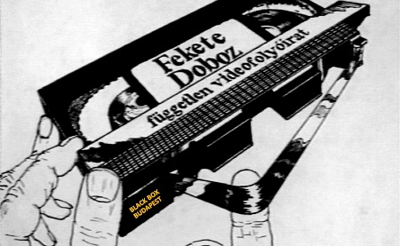
Videos on regime change in Hungary 1988-1996
3000 h of video from an independent media group.
Opposition movements, demonstrations, S-VHS PAL
Notes:
The single largest independent media group’s (CALLED FEKETE DOBOZ, THATIS BLACK BOX) video archive relating to the regime change in Hungary

Slide 13
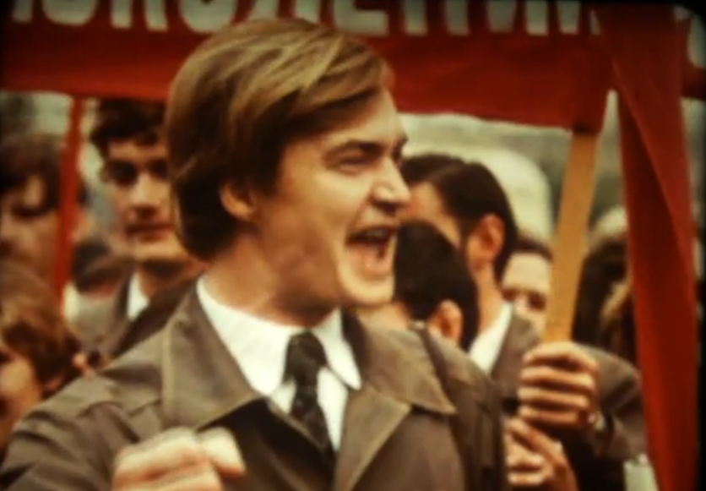
Soviet Propaganda Film Collection 1947-1987
Popular science, industry, agricultural, army, nature, music, youth and sport films, and also some newsreels. 16mm
Notes:
An orphan collection of soviet propaganda films

Slide 14
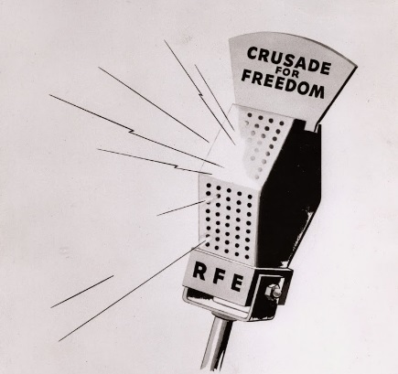
RFE / RL 1953-1995 Russian language Broadcast Archive
26’147 unique audio files that were produced and broadcast by RFE/RL’s Russian Services.
MP3
Notes:
The Russian language broadcast archive of RFE/RL

Slide 15
Monitoring of the Iraqi Television 2003
Off-air recordings by OSA of patriotic news and propaganda, broadcast by Iraqi State Television during the first three weeks of the 2003 American-led invasion of Iraq.
VHS PAL
Notes:
Video archive of the last weeks of the Saddam regime, through off air recordings of the Iraqi central television

Slide 16
PHR Training Videos 1995-1999
Programs and footage from 1995-1999 on Physicians for Human Rights' work to identify victims of the Srebrenica massacre, including educational programs as well.
VHS PAL
Notes:
Physicians for Human Rights training videos

Slide 17
International Monitor Institute videos 1980-2002
Genocide Archive 5’000 hours of video documenting genocide in Europe, Asia the Middle East and Africa in the1990s and early 2000s.
BETA SP NTSC
Notes:
AND the genocide archive of the International Monitor Institute

Slide 18
AV digital preservation. Preparation phase1
2013 Inventory of analogue AV holdings
Extent and format per series
Date of analog carriers (age)
Descriptive metadata available Y/N (=if catalogued or not)
Copyright holder: OSA / not-OSA / orphan
🡪 Priority list for scheduled digitization
Notes:
By 2012 most of OSA’s collections have reached a critical age. Even thought OSA has an OK cold storage, an analogue to digital conversion has had to be scheduled.
At the AV unit, we’ve created a full inventory of all of our holdings. Extents and formats, age of analogue carriers, their copyright status, and whether or not the material was intellectually processed was determined. Combining these factors, a priority list was created.

Slide 19
Preparation phase2 Vision for the future
2016 business case by AV archivists + IT
negotiated with the management 🡪 institutional commitment $$
Consensus: OSA needs a consultant=external expert
Terms of reference TOR phrased
Notes:
By 2016 a business case was created, as a collaborative project between the AV, IT, and the management, that resulted in an institutional commitment. A budget was allocated for a long term digital preservation, and a ‘terms of reference’ was phrased to invite an external expert, that is a consultant.

Slide 20
External expert
to assess OSA’s capability for long-term digital preservation
to define standards, practices, systems, workflows and tools for digitizing AV content for long-term preservation
to develop a digital preservation strategy
Notes:
A consultant was to assess OSA’s capability for long-term digital preservation; to define standards, systems, equipment and workflows for digitizing and managing AV content; and to develop a digital preservation strategy.

Slide 21
Consultancy + training March 2017
Built on the understanding of the reference model for OAIS
Readiness to learn + a set of skills for transcoding and using ffmpeg@OSA
2-day consultancy + training in ffmpeg, qctools
2017.07: “Microservices in AV Archives”
Worflows+tools: defined and designed
Notes:
The consultancy took place in March 2017. It was built on the understanding of the reference model for OAIS. And that there is readiness to learn, and a set of skills for transcoding and using ffmpeg at OSA.
The 2-day consultancy included training sessions in ffmpeg and qctools. In July 2017 “Microservices in AV Archives” was ready and published by the consultant Dave Rice, in which workflows and tools were defined and designed.

Slide 22
Workflow 1: Digitization and Pre-Ingest_AV staff
Manual part of the workflow, managed by the AV team
Start with raw materials = archival analogue master
scenario1: contents already described;
scenario2: contents will be described following digitization
Notes:
I’m going to conclude with a sketch of workflow1, that is digitization and pre-ingest, and then will give the floor to my colleagues to continue with the next phases. Workfow1 is a manual part of the workflow, managed by the AV archive team. It starts with raw materials, that are the analogue masters. In scenario1 the contents is already described, so there is a full set of descriptive metadata within the finding aids module of the AMS. IN scenario2 only the ‘container records’ are there within the AMS, the contents will be described following digitization.

Slide 23
Workflow 1: Digitization and Pre-Ingest – cont.
Through identification assignment (physical barcoding), chipping barcode into AMS, digitization, quality control, and approval the preservation master is created and is on external HDD, submitted to IT
_equipment, settings and artifacts by Darius Krolikowski, AV Archivist
Notes:
Through physical barcoding, then chipping the barcode into AMS, digitization, quality control and approval the PRESERVATION MASTER ffv1 file is created onto an external HDD, and is ready for submission to IT. I give the floor to Darius now.

